Slide 1

HealthCare Inventory Management System
Abhilash Wase
Ajith Babu Ramesh
Keshav K L

Slide 2

Problem Statement
Since Covid-19 is on the rise, there is a growing shortage or improper management of Covid-19 testing kits that are crucial.
We aim to develop a system that connects different elements within the Healthcare System and the Vendors that produce the Testing kits to ensure quick and efficient distribution of the kits and related supplies.

Slide 3
Solution
• This application will enable Hospitals to manage inventory (Testing Kits), raise requests based on demand and continue to update stock and data on a regular basis.
• The Pharmacies can see the trend in demand and consumption for certain hospitals for kits and can prepare for distribution and dispatch before receiving an actual request.
• Organizations who are not registered with the health care system who provide necessary supplies can also make requests.
• This system will also deal with the proper disposal of hazardous waste in hospitals by connecting to the Waste management Organization.

Slide 4
Approach
This system will efficiently organize and connect the enterprises to manage data and inventory.
We have integrated multiple organizations that play their role efficiently to manage the inventory
Hospitals and NGOs can make stock requests (Testing Kits and related supplies) from the Vendor (Pharmacy) and also update their consumption accordingly
Proper disposal of Hazardous waste is also managed by the Waste Management Organization

Slide 5
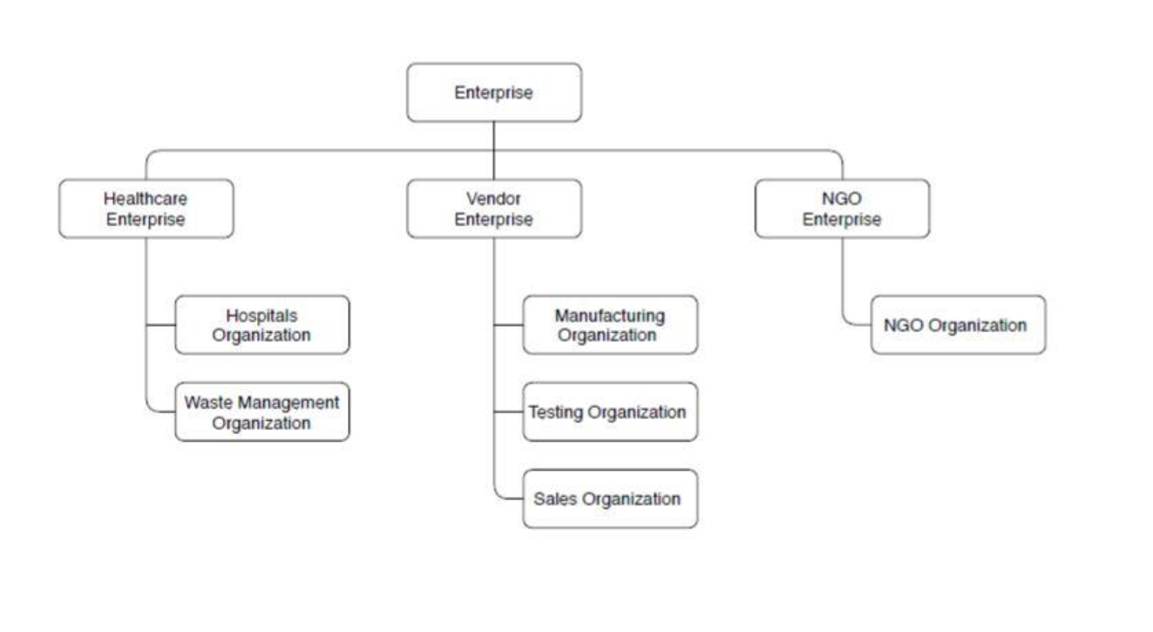
System Diagram

Slide 6
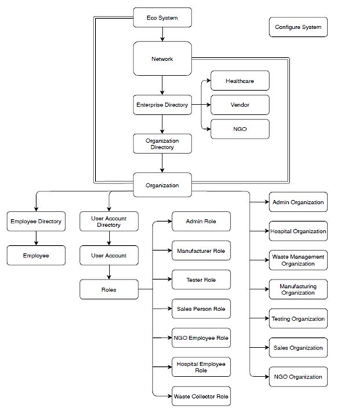
Architecture Diagram

Slide 7
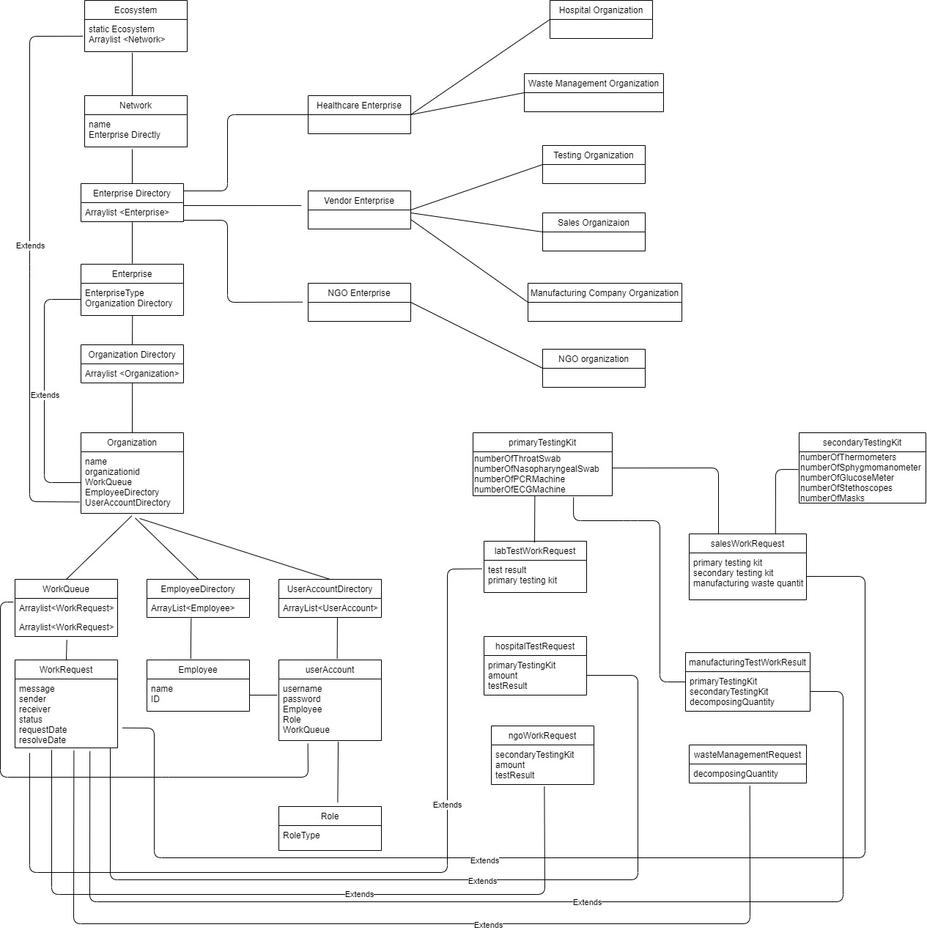
Object Model Diagram

Slide 8
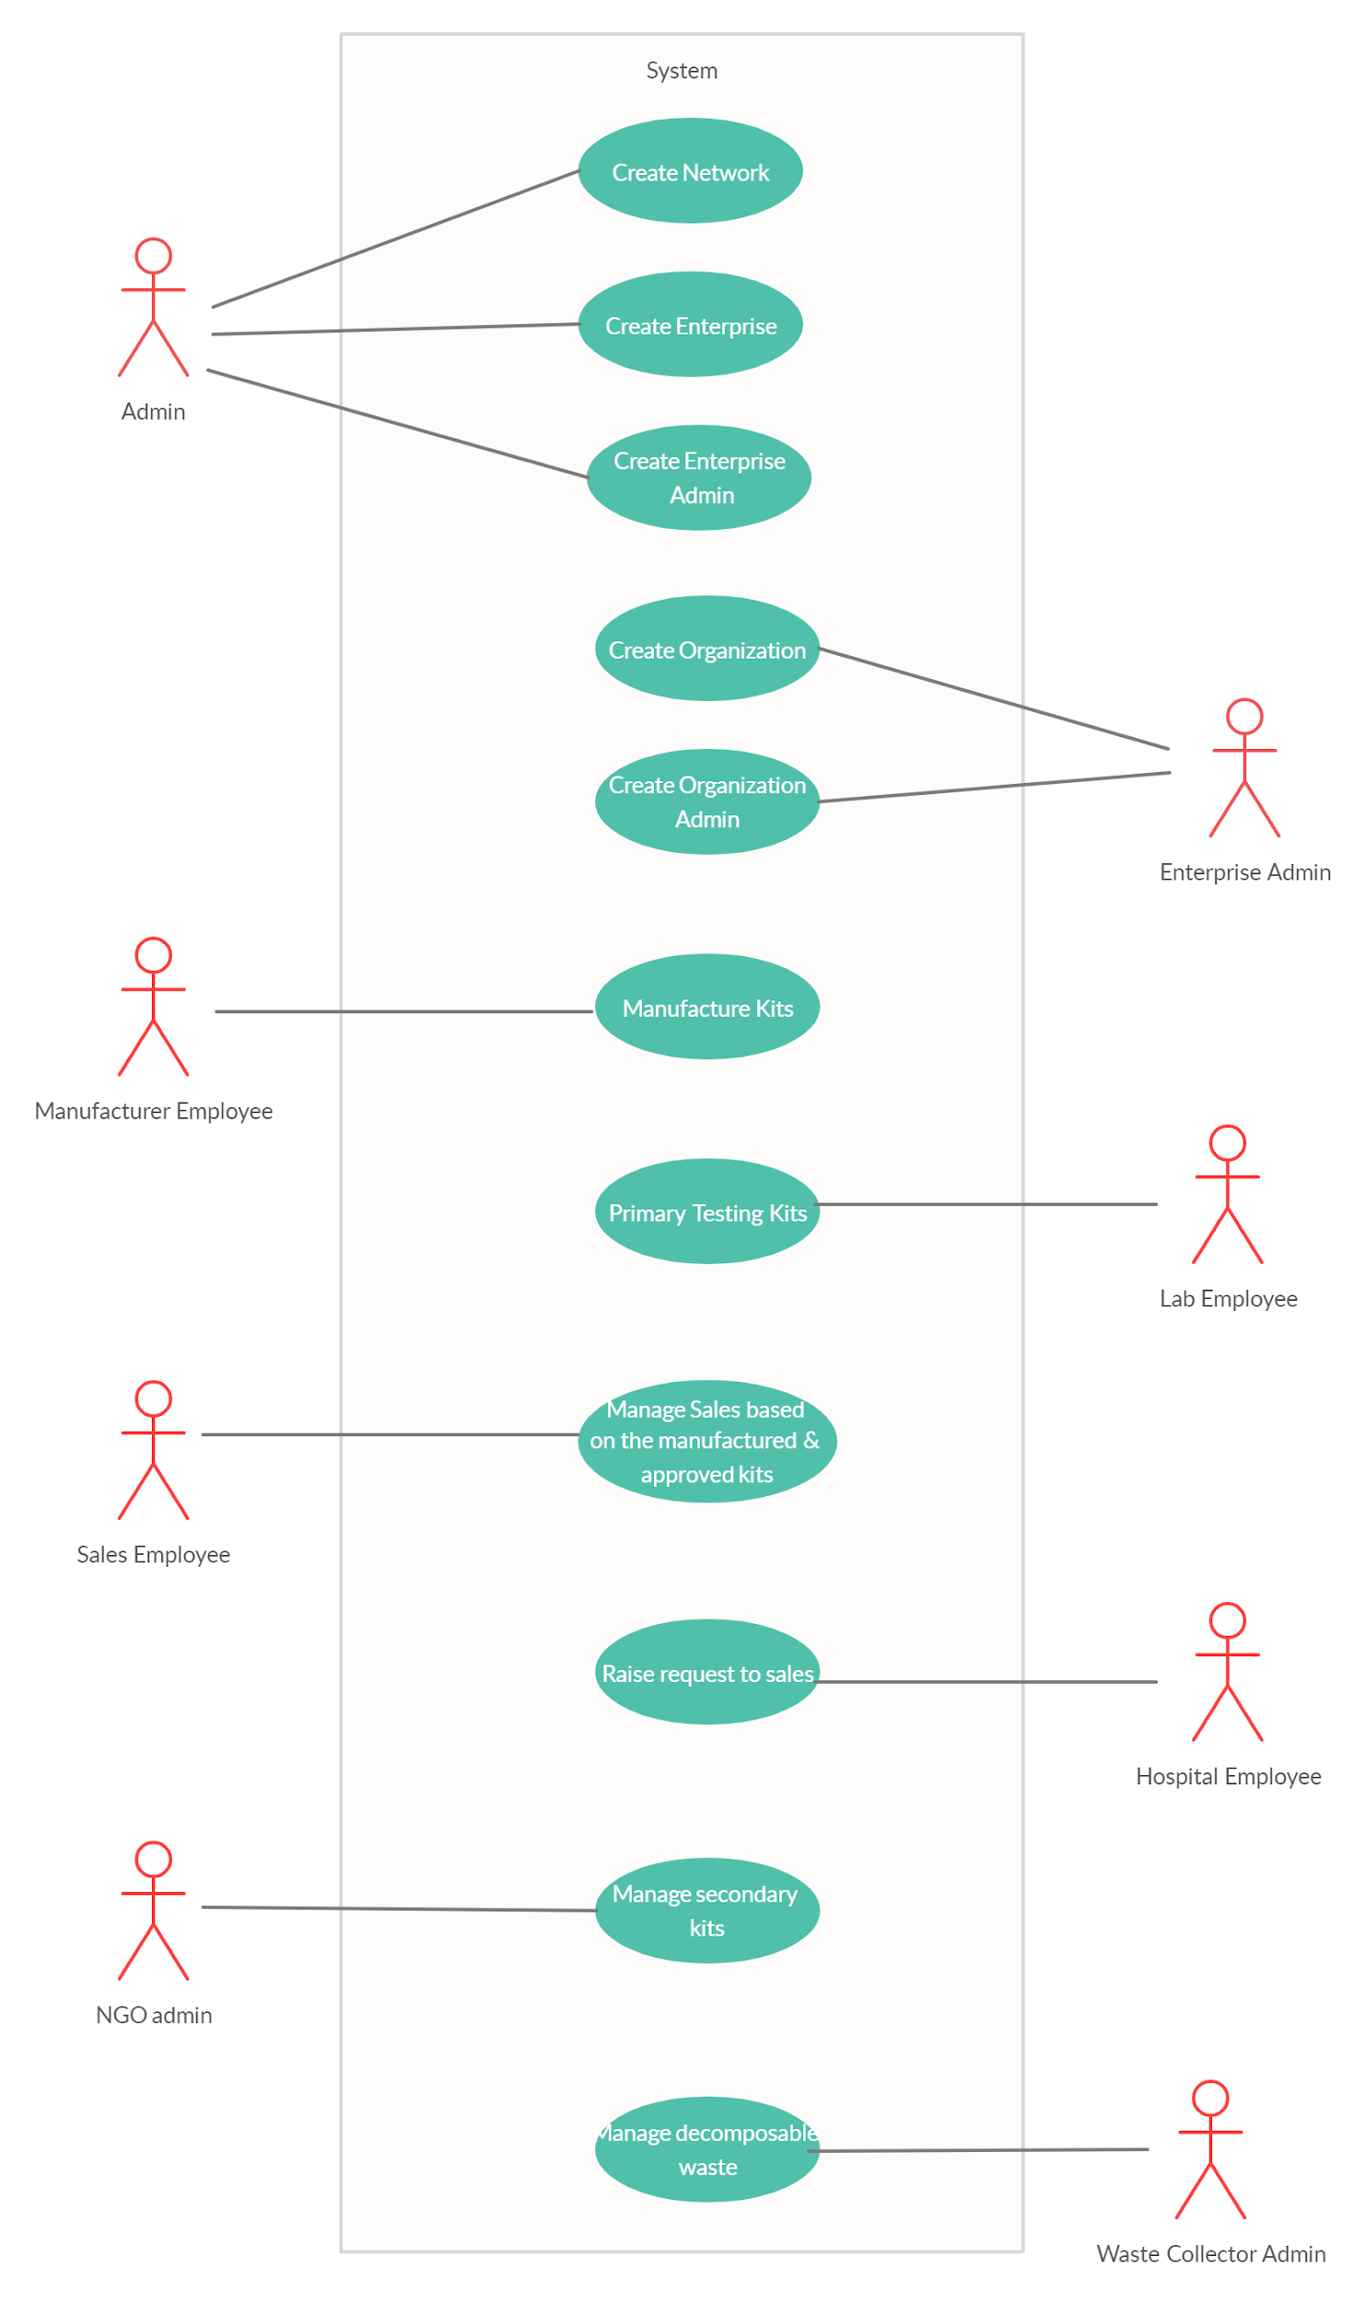
Use Case Diagram

Slide 9
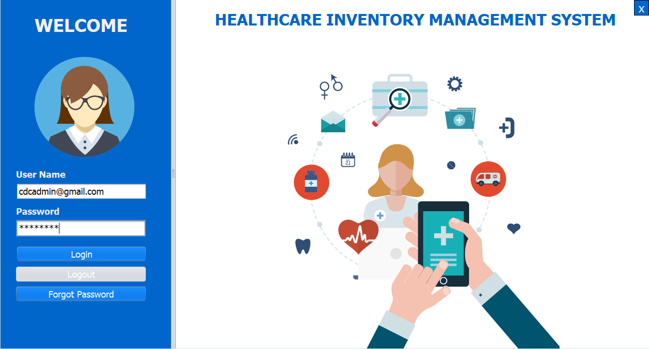
Application Screenshots

Slide 10
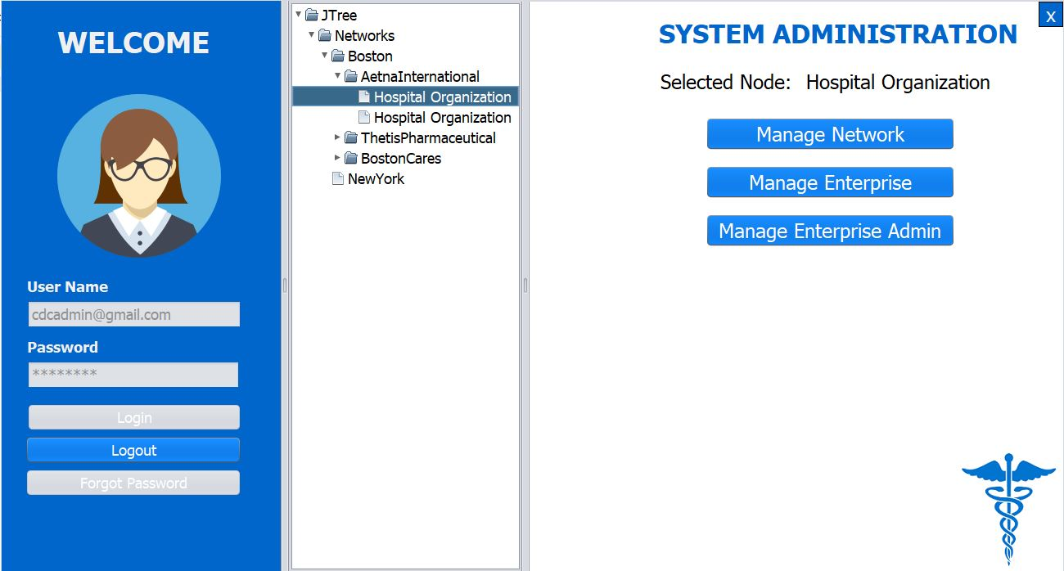
Application Screenshots

Slide 11
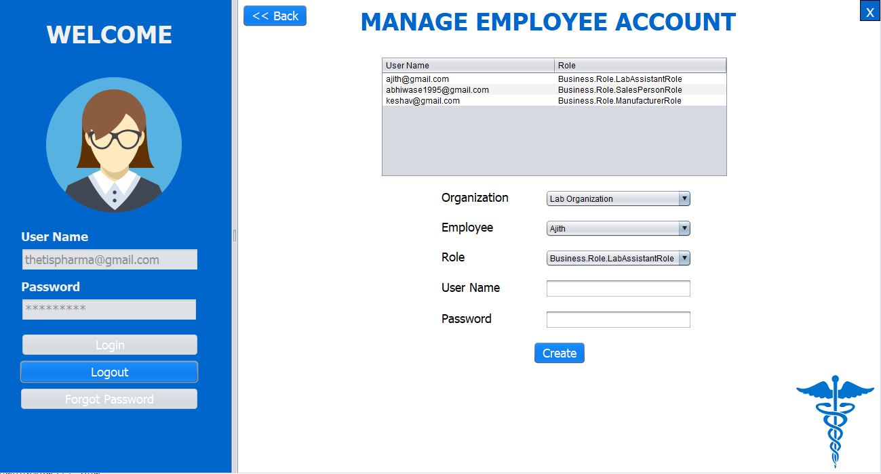
Application Screenshots

Slide 12
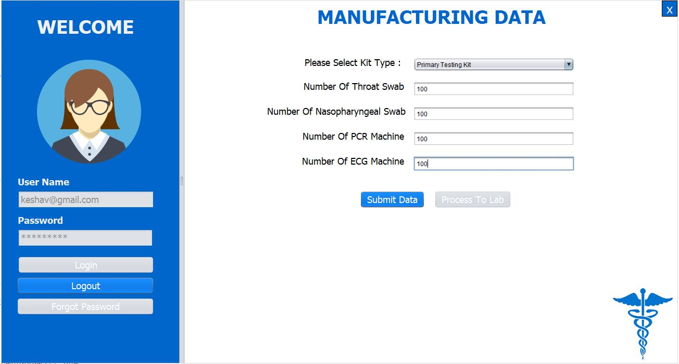
Application Screenshots

Slide 13
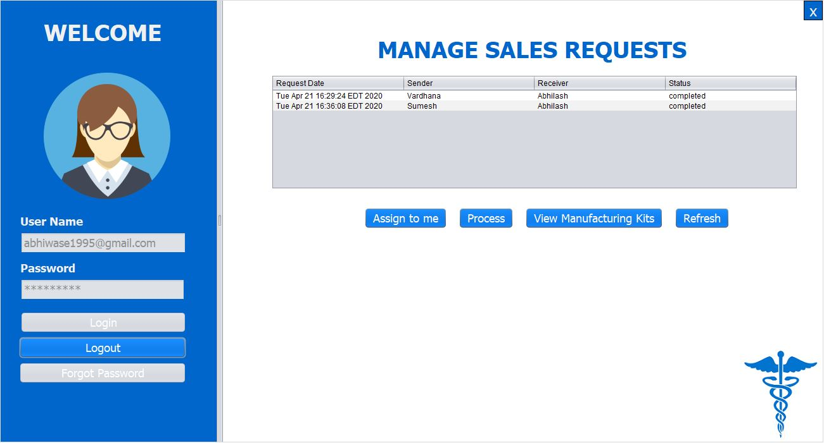
Application Screenshots

Slide 14
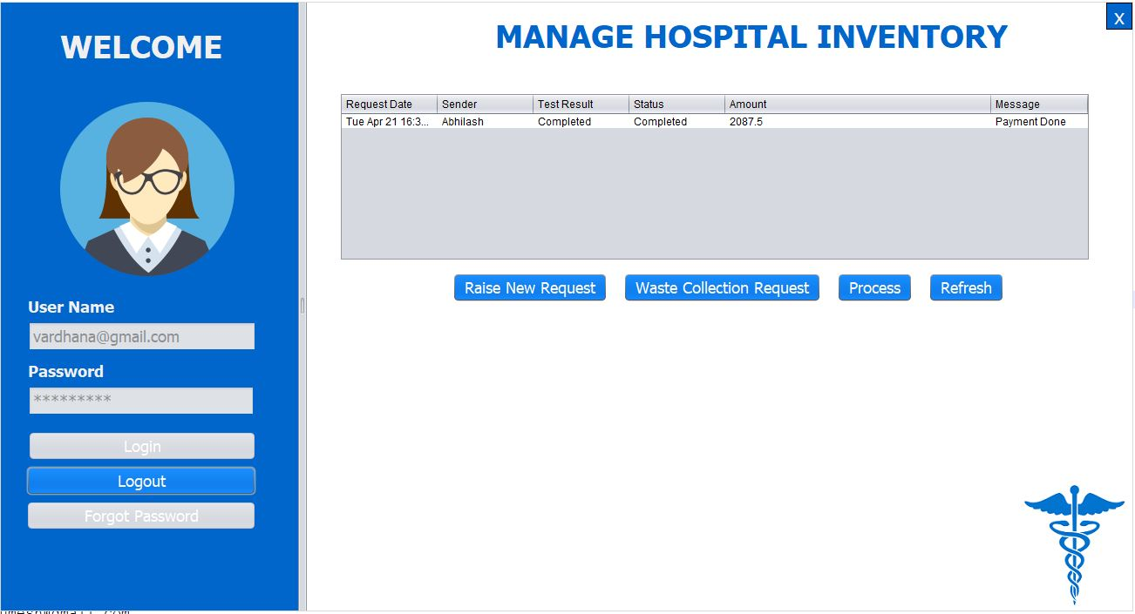
Application Screenshots

Slide 15


